Slide 1
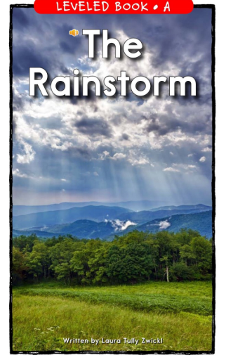

Slide 2
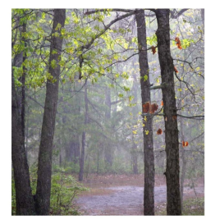
The Rainstorm

Slide 3
Click to see the contrast before and after the storm.
rainbow
puddle
lightning
clouds
rain
sky

Slide 4

I see the Sun.
return

Slide 5

I see the sky
return

Slide 6
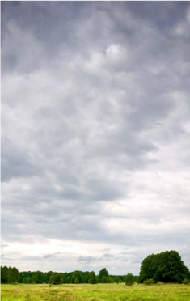
I see the clouds.
return

Slide 7
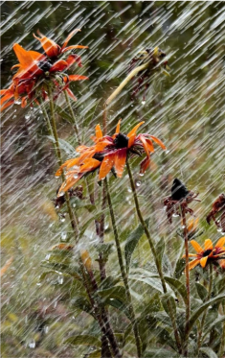
I see the rain.
return

Slide 8
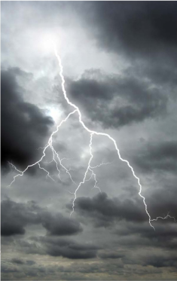
I see the lightning
return

Slide 9
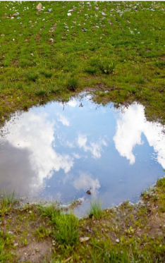
I see the puddle.
return

Slide 10
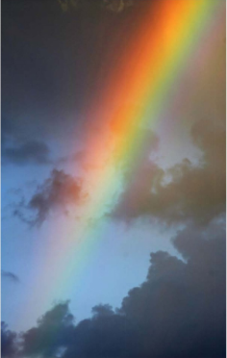
I see the rainbow
return

